Slide 1
Simple Chatbot using BERT
atjahyanto@gmail.com

Slide 2
Simple Chatbot using BERT
Developing a chatbot using a BERT model involves several steps, including data collection, fine-tuning the BERT model for conversational understanding, and integrating the model into a chatbot interface.
Data Collection: Gather a dataset of conversational data that will be used to train the BERT model. This dataset should include pairs of questions and responses.
Preprocessing: Preprocess the conversational data to tokenize the text and convert it into a format suitable for training the BERT model
Fine-Tuning BERT: Fine-tune a pre-trained BERT model on the conversational data using a task-specific objective, such as sequence classification or sequence-to-sequence modeling. During fine-tuning, the BERT model learns to generate appropriate responses based on the input questions and context.
Evaluation: Evaluate the performance of the fine-tuned BERT model on a held-out dataset to assess its ability to generate accurate and contextually relevant responses.

Slide 3
Simple Chatbot using BERT
data = {"intents": [
{"tag": "greeting",
"responses": ["Howdy Partner!", "Hello", "How are you doing?", "Greetings!", "How do you do?"]},
{"tag": "age",
"responses": ["I am 25 years old", "I was born in 1998", "My birthday is July 3rd and I was born in 1998", "03/07/1998"]},
{"tag": "date",
"responses": ["I am available all week", "I don't have any plans", "I am not busy"]},
{"tag": "name",
"responses": ["My name is James", "I'm James", "James"]},
{"tag": "goodbye",
"responses": ["It was nice speaking to you", "See you later", "Speak soon!"]}
]}

Slide 4
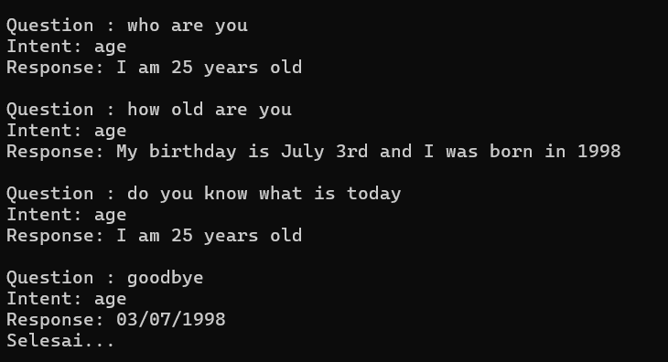
Simple Chatbot using BERT
# https://medium.com/geekculture/simple-chatbot-using-bert-and-pytorch-part-2-ef48506a4105
# pip install torchinfo
import re
import numpy as np
import random
import torch
import torch.nn as nn
from sklearn.model_selection import train_test_split
from transformers import BertTokenizer, BertForSequenceClassification, Trainer, TrainingArguments
import torch
import numpy as np
# used a dictionary to represent an intents JSON file
data = {"intents": [
{"tag": "greeting",
"responses": ["Howdy Partner!", "Hello", "How are you doing?", "Greetings!", "How do you do?"]},
{"tag": "age",
"responses": ["I am 25 years old", "I was born in 1998", "My birthday is July 3rd and I was born in 1998", "03/07/1998"]},
{"tag": "date",
"responses": ["I am available all week", "I don't have any plans", "I am not busy"]},
{"tag": "name",
"responses": ["My name is James", "I'm James", "James"]},
{"tag": "goodbye",
"responses": ["It was nice speaking to you", "See you later", "Speak soon!"]}
]}
# Extract tags from the intents
tags = [intent["tag"] for intent in data["intents"]]
categories = np.unique(tags)
print (categories)
# Load the BERT tokenizer
tokenizer = BertTokenizer.from_pretrained('bert-base-uncased')
bert_asli=0
if (bert_asli==1):
nama_model = 'bert-base-uncased'
else:
nama_model = "./fine_tuned_chatbot-bert_model"
model = BertForSequenceClassification.from_pretrained(nama_model, num_labels=len(categories))
# Based on the histogram we are selecting the max len as 8
max_seq_len = 8
# Check if GPU is available
device = torch.device("cuda" if torch.cuda.is_available() else "cpu")
# push the model to GPU
model = model.to(device)
from torchinfo import summary
summary(model)
#-----------------------------------
label_list = ['date', 'name', 'date', 'date', 'goodbye']
# Converting the labels into encodings
from sklearn.preprocessing import LabelEncoder
le = LabelEncoder()
embuh = le.fit_transform(label_list)
def get_predictionX(str):
str = re.sub(r'[^a-zA-Z ]+', '', str)
test_text = [str]
model.eval()
tokens_test_data = tokenizer(test_text, max_length = max_seq_len, pad_to_max_length=True, truncation=True,
return_token_type_ids=False
)
test_seq = torch.tensor(tokens_test_data['input_ids'])
test_mask = torch.tensor(tokens_test_data['attention_mask'])
preds = None
with torch.no_grad():
preds = model(test_seq.to(device), test_mask.to(device))
preds = preds.detach().cpu().numpy()
preds = np.argmax(preds, axis = 1)
print("Intent Identified: ", le.inverse_transform(preds)[0])
return le.inverse_transform(preds)[0]
def get_prediction(str):
example_text = re.sub(r'[^a-zA-Z ]+', '', str)
# Tokenize input text
inputs = tokenizer(example_text, padding=True, truncation=True, return_tensors='pt')
# Perform inference
with torch.no_grad():
outputs = model(**inputs)
# Get predicted logits
logits = outputs.logits
# Convert logits to probabilities
probs = torch.softmax(logits, dim=-1)
# Get predicted label (index of the maximum probability)
predicted_label_index = torch.argmax(probs, dim=-1).item()
# Get corresponding label name
predicted_label = categories[predicted_label_index]
return predicted_label
def get_response(message):
intent = get_prediction(message)
for i in data['intents']:
if i["tag"] == intent:
result = random.choice(i["responses"])
break
# print(f"Response : {result}")
return "Intent: "+ intent + '\n' + "Response: " + result
pertanyaan_list = ["who are you", "how old are you", "do you know what is today", "goodbye"]
for pertanyaan in pertanyaan_list:
print()
print(f"Question : {pertanyaan}")
print (get_response(pertanyaan))
print ("Selesai...")
bert_asli=1
if (bert_asli==1):
nama_model = 'bert-base-uncased'
else:
nama_model = "./fine_tuned_chatbot-bert_model"
model = BertForSequenceClassification.from_pretrained(nama_model, num_labels=len(categories))

Slide 5
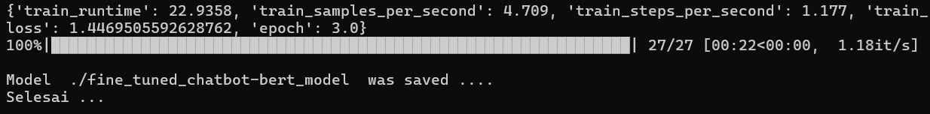
Retrain BERT Model for Chatbot
import numpy as np
import pandas as pd
from sklearn.model_selection import train_test_split
from transformers import BertTokenizer, BertForSequenceClassification, Trainer, TrainingArguments
import torch
# specify GPU
# device = torch.device("cuda")
# Check if GPU is available
device = torch.device("cuda" if torch.cuda.is_available() else "cpu")
# We have prepared a chitchat dataset with 5 labels
df = pd.read_excel("chitchat.xlsx")
print (df.head())
# buat sedemikian rupa sehingga untuk setiap label terdapat sekitar 100 buah
print (df['labelx'].value_counts())
# Converting the labels into encodings
from sklearn.preprocessing import LabelEncoder
le = LabelEncoder()
df['label'] = le.fit_transform(df['labelx'])
# check class distribution
print (df['label'].value_counts(normalize = True))
categories = np.unique(list(df['labelx']))
print (categories)
# In this example we have used all the utterances for training purpose
train_text, train_labels = list(df['text']), list(df['label'])
print (train_labels)
#-------------------------------------------------
# Split the dataset into training and validation sets
train_texts, val_texts, train_labels, val_labels = train_test_split(
train_text, train_labels, random_state=42, test_size=0.2
)
print (type(train_texts))
print (type(val_texts))
#import sys
#sys.exit()
# Load BERT tokenizer
tokenizer = BertTokenizer.from_pretrained('bert-base-uncased')
# Tokenize input texts
train_encodings = tokenizer(train_texts, padding=True, truncation=True)
val_encodings = tokenizer(val_texts, padding=True, truncation=True)
# Define PyTorch datasets
class PyTorchDataset(torch.utils.data.Dataset):
def __init__(self, encodings, labels):
self.encodings = encodings
self.labels = labels
def __getitem__(self, idx):
item = {key: torch.tensor(val[idx]) for key, val in self.encodings.items()}
item['labels'] = torch.tensor(self.labels[idx])
return item
def __len__(self):
return len(self.labels)
train_dataset = PyTorchDataset(train_encodings, train_labels)
val_dataset = PyTorchDataset(val_encodings, val_labels)
# Fine-tune a pre-trained BERT model
model = BertForSequenceClassification.from_pretrained('bert-base-uncased', num_labels=len(categories))
training_args = TrainingArguments(
output_dir="test_trainer",
per_device_train_batch_size=4,
per_device_eval_batch_size=4,
num_train_epochs=3,
logging_dir='./logs',
)
trainer = Trainer(
model=model,
args=training_args,
train_dataset=train_dataset,
eval_dataset=val_dataset,
)
# Train the model
trainer.train()
# Save the fine-tuned model
output_dir = "./fine_tuned_chatbot-bert_model"
model.save_pretrained(output_dir)
print ()
print ("Model ", output_dir, " was saved ....")
print ("Selesai ...")
Model BERT
Retraining
Fine tuned
Model BERT
Data Excel

Slide 6
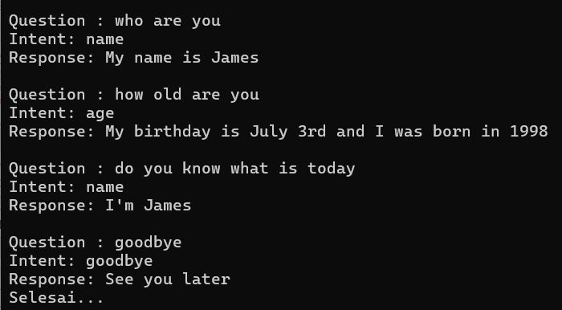
Simple Chatbot using BERT
# https://medium.com/geekculture/simple-chatbot-using-bert-and-pytorch-part-2-ef48506a4105
# pip install torchinfo
import re
import numpy as np
import random
import torch
import torch.nn as nn
from sklearn.model_selection import train_test_split
from transformers import BertTokenizer, BertForSequenceClassification, Trainer, TrainingArguments
import torch
import numpy as np
# used a dictionary to represent an intents JSON file
data = {"intents": [
{"tag": "greeting",
"responses": ["Howdy Partner!", "Hello", "How are you doing?", "Greetings!", "How do you do?"]},
{"tag": "age",
"responses": ["I am 25 years old", "I was born in 1998", "My birthday is July 3rd and I was born in 1998", "03/07/1998"]},
{"tag": "date",
"responses": ["I am available all week", "I don't have any plans", "I am not busy"]},
{"tag": "name",
"responses": ["My name is James", "I'm James", "James"]},
{"tag": "goodbye",
"responses": ["It was nice speaking to you", "See you later", "Speak soon!"]}
]}
# Extract tags from the intents
tags = [intent["tag"] for intent in data["intents"]]
categories = np.unique(tags)
print (categories)
# Load the BERT tokenizer
tokenizer = BertTokenizer.from_pretrained('bert-base-uncased')
bert_asli=0
if (bert_asli==1):
nama_model = 'bert-base-uncased'
else:
nama_model = "./fine_tuned_chatbot-bert_model"
model = BertForSequenceClassification.from_pretrained(nama_model, num_labels=len(categories))
# Based on the histogram we are selecting the max len as 8
max_seq_len = 8
# Check if GPU is available
device = torch.device("cuda" if torch.cuda.is_available() else "cpu")
# push the model to GPU
model = model.to(device)
from torchinfo import summary
summary(model)
#-----------------------------------
label_list = ['date', 'name', 'date', 'date', 'goodbye']
# Converting the labels into encodings
from sklearn.preprocessing import LabelEncoder
le = LabelEncoder()
embuh = le.fit_transform(label_list)
def get_predictionX(str):
str = re.sub(r'[^a-zA-Z ]+', '', str)
test_text = [str]
model.eval()
tokens_test_data = tokenizer(test_text, max_length = max_seq_len, pad_to_max_length=True, truncation=True,
return_token_type_ids=False
)
test_seq = torch.tensor(tokens_test_data['input_ids'])
test_mask = torch.tensor(tokens_test_data['attention_mask'])
preds = None
with torch.no_grad():
preds = model(test_seq.to(device), test_mask.to(device))
preds = preds.detach().cpu().numpy()
preds = np.argmax(preds, axis = 1)
print("Intent Identified: ", le.inverse_transform(preds)[0])
return le.inverse_transform(preds)[0]
def get_prediction(str):
example_text = re.sub(r'[^a-zA-Z ]+', '', str)
# Tokenize input text
inputs = tokenizer(example_text, padding=True, truncation=True, return_tensors='pt')
# Perform inference
with torch.no_grad():
outputs = model(**inputs)
# Get predicted logits
logits = outputs.logits
# Convert logits to probabilities
probs = torch.softmax(logits, dim=-1)
# Get predicted label (index of the maximum probability)
predicted_label_index = torch.argmax(probs, dim=-1).item()
# Get corresponding label name
predicted_label = categories[predicted_label_index]
return predicted_label
def get_response(message):
intent = get_prediction(message)
for i in data['intents']:
if i["tag"] == intent:
result = random.choice(i["responses"])
break
# print(f"Response : {result}")
return "Intent: "+ intent + '\n' + "Response: " + result
pertanyaan_list = ["who are you", "how old are you", "do you know what is today", "goodbye"]
for pertanyaan in pertanyaan_list:
print()
print(f"Question : {pertanyaan}")
print (get_response(pertanyaan))
print ("Selesai...")
bert_asli=0
if (bert_asli==1):
nama_model = 'bert-base-uncased'
else:
nama_model = "./fine_tuned_chatbot-bert_model"
model = BertForSequenceClassification.from_pretrained(nama_model, num_labels=len(categories))

